Slide 1
Research examples
Sonja Aits
“AI for Medicine and Life Science – AI for image and video data”, Lund University
20211025

Slide 2
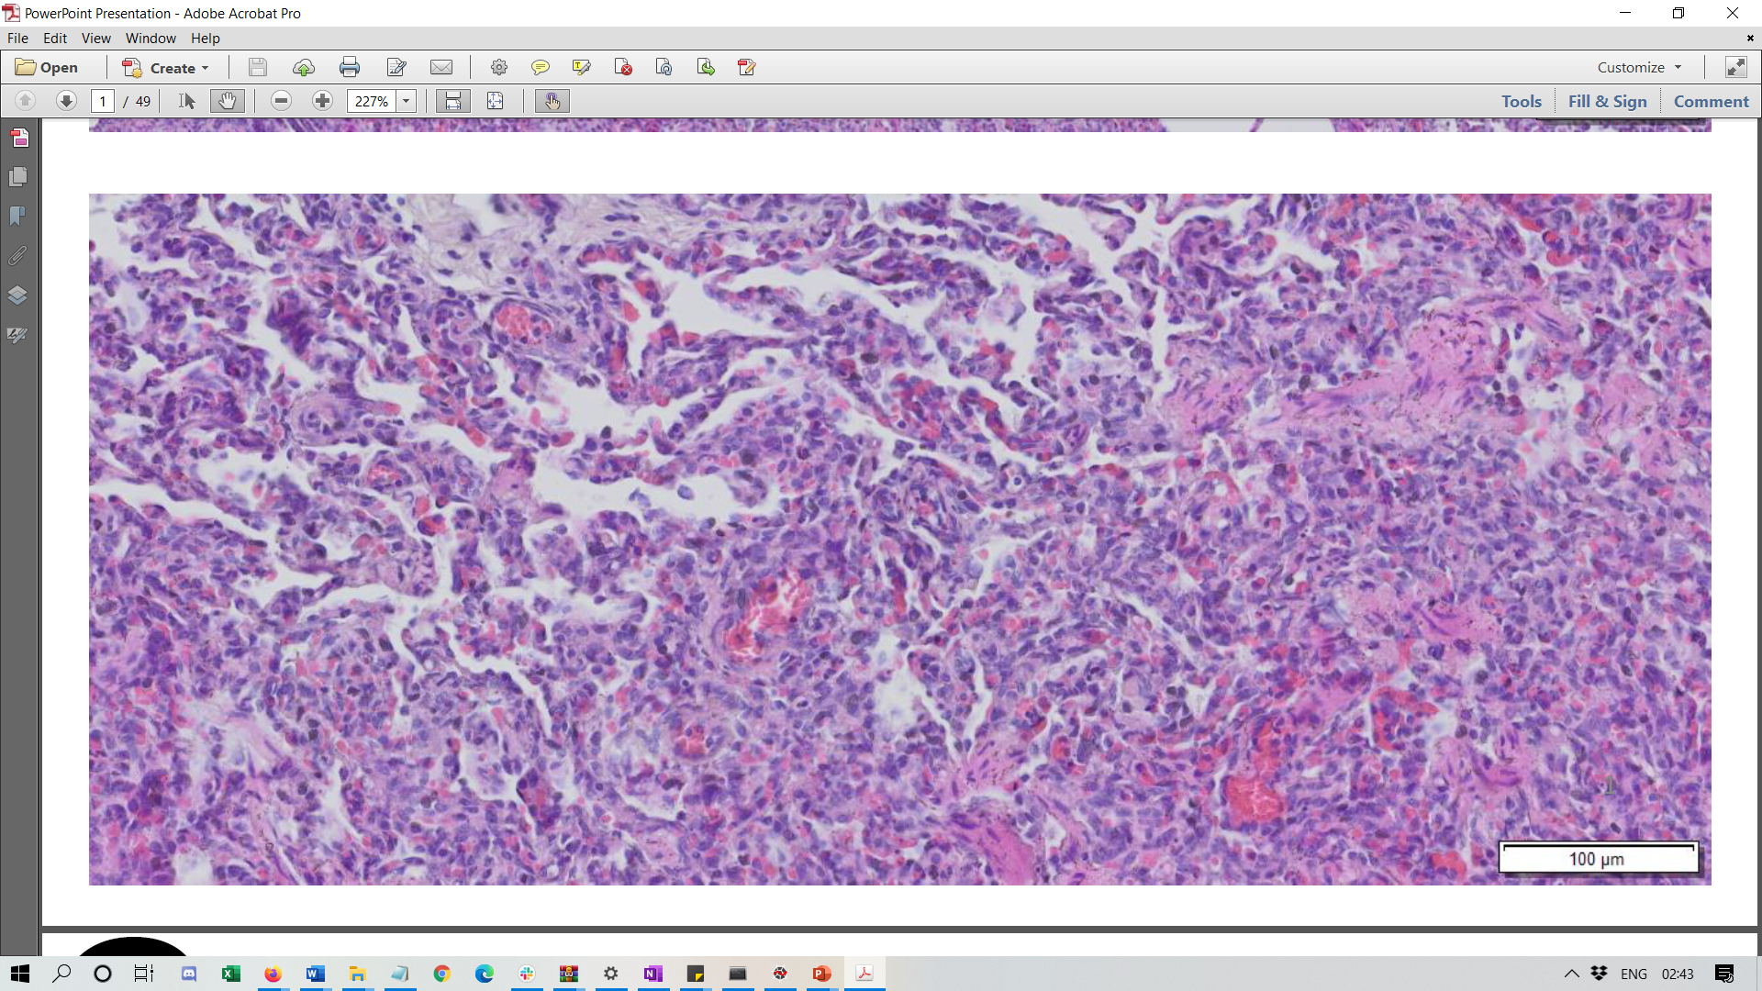

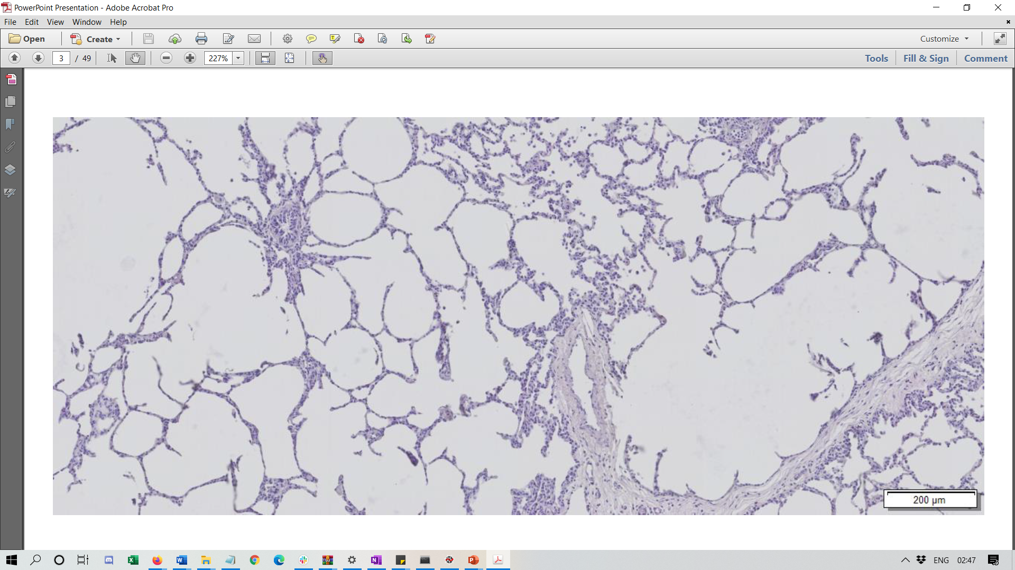
Deep learning for histology
Feature Score
A 6
B 4
C 7
Damaged tissue
Feature Score
A 0
B 1
C 0
Normal tissue
SciLifeLab/KAW National COVID-19 Research Program
Images from collaborator Darcy Wagner

Slide 3
Issues with human scorers
Slow
Poor correlation between scorers
→ Can deep learning enable rapid and reproducible scoring?

Slide 4
Project progression
data ok
feasible
Experiments
Different augmentations
Different architectures
Different hyperparameters
Data exploration
Pilot experiments
Inspect results
data not ok
not feasible
not satisfied
Adjust data/task
Adjust models

Slide 5
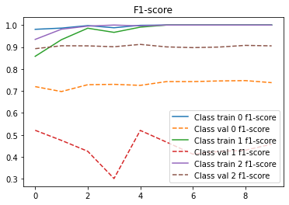
Inspecting performance in detail

Slide 6
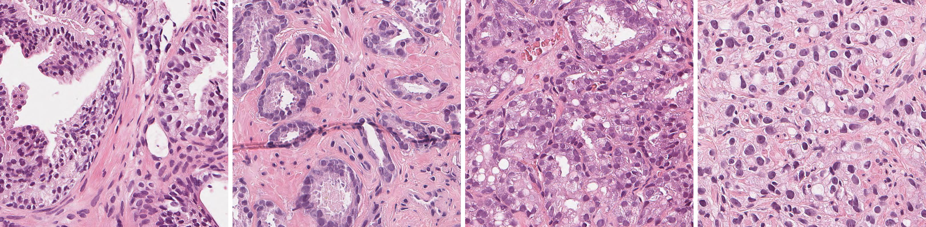
Computer vision for prostate cancer scoring
Microscopy images of prostate biopsies stained with haematoxylin and eosin (H&E) -> Gleason grade
Benign
Gleason grade 3
Gleason grade 4
Gleason grade 5
Automatic Gleason grading of H&E stained microscopic prostate images using deep convolutional neural networks, Gummeson, A., Arvidsson, I., Ohlsson, M., Overgaard, N. C., Krzyzanowska, A., Heyden, A., Bjartell, A. & Aström, K., 2017, Medical Imaging 2017: Digital Pathology. SPIE, Vol. 10140, 101400S
Generalization of prostate cancer classification for multiple sites using deep learning, Arvidsson, I., Overgaard, N. C., Marginean, F. E., Krzyzanowska, A., Bjartell, A., Astrom, K. & Heyden, A., 2018 May 23, 2018 IEEE 15th International Symposium on Biomedical Imaging, ISBI 2018. IEEE Computer Society, Vol. 2018-April, p. 191-194 4 p.

Slide 7
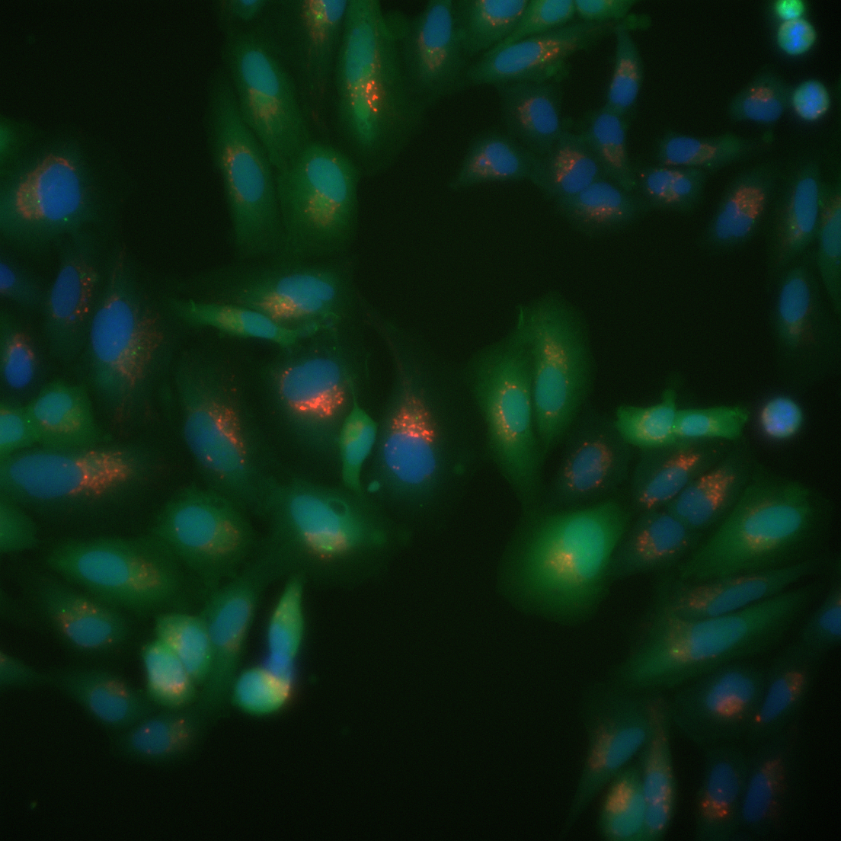
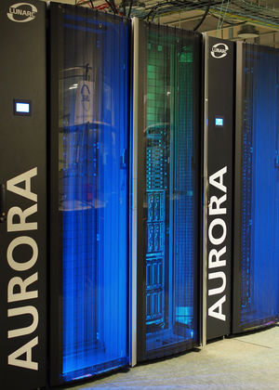
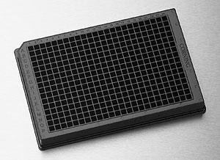
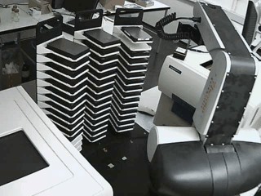
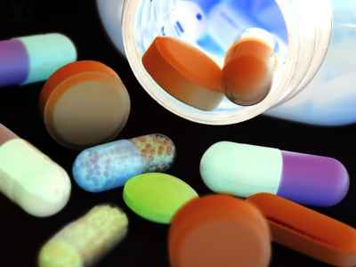
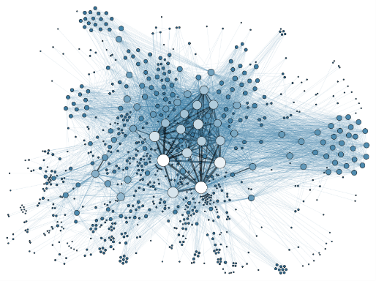
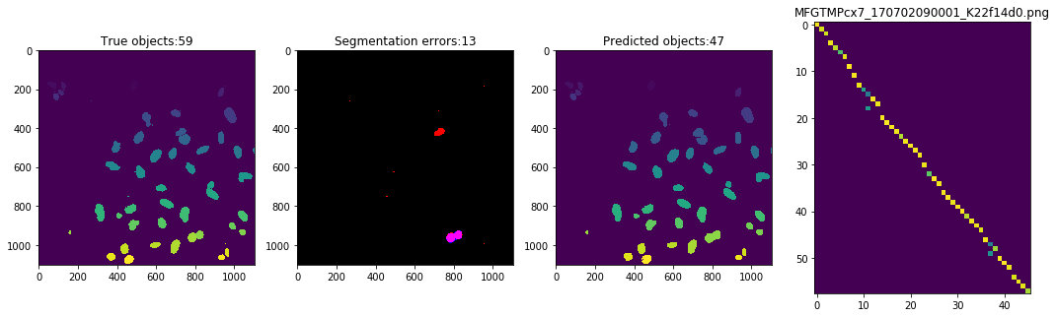
Computer vision for high-throughput microscopy screening
Classification/Scoring/
Clustering
Segmentation

Slide 8
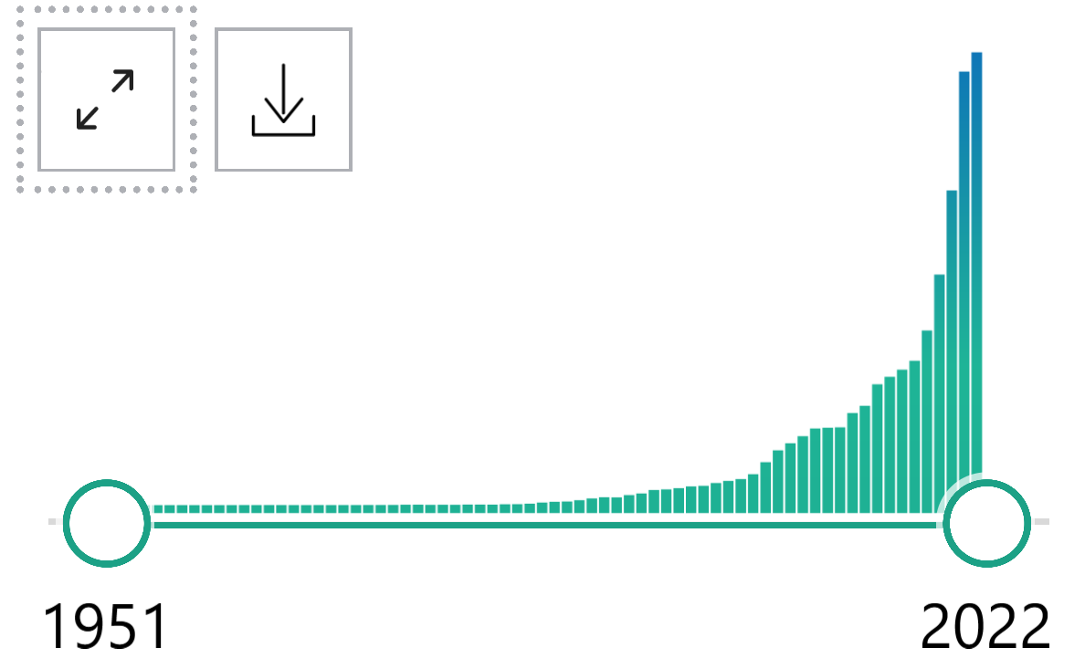
Biomedical AI research has exploded

Slide 9
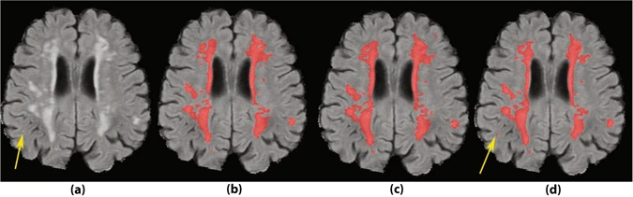
AI can detect things that humans may miss and vice versa
Scorer 1
Scorer 2
AI
Area missed by
human scorers
Ghafoorian et al. Sci Rep 2017 Jul 11;7(1):5110

Slide 10
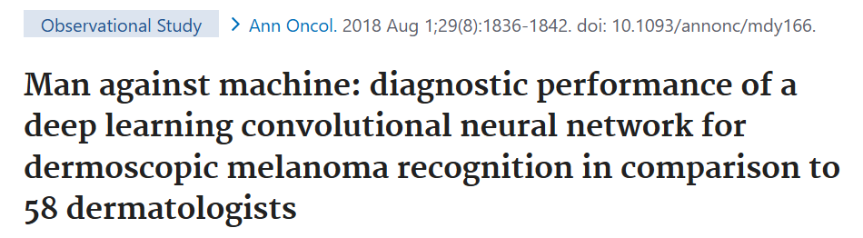
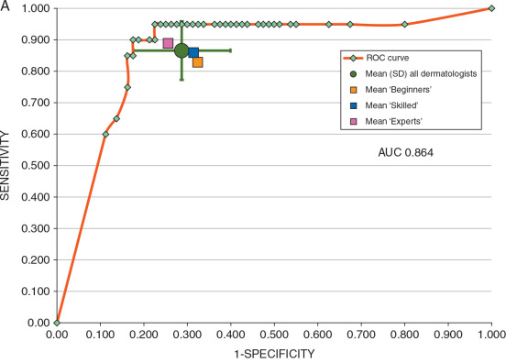
AI surpasses human performance in many individual studies

Slide 11
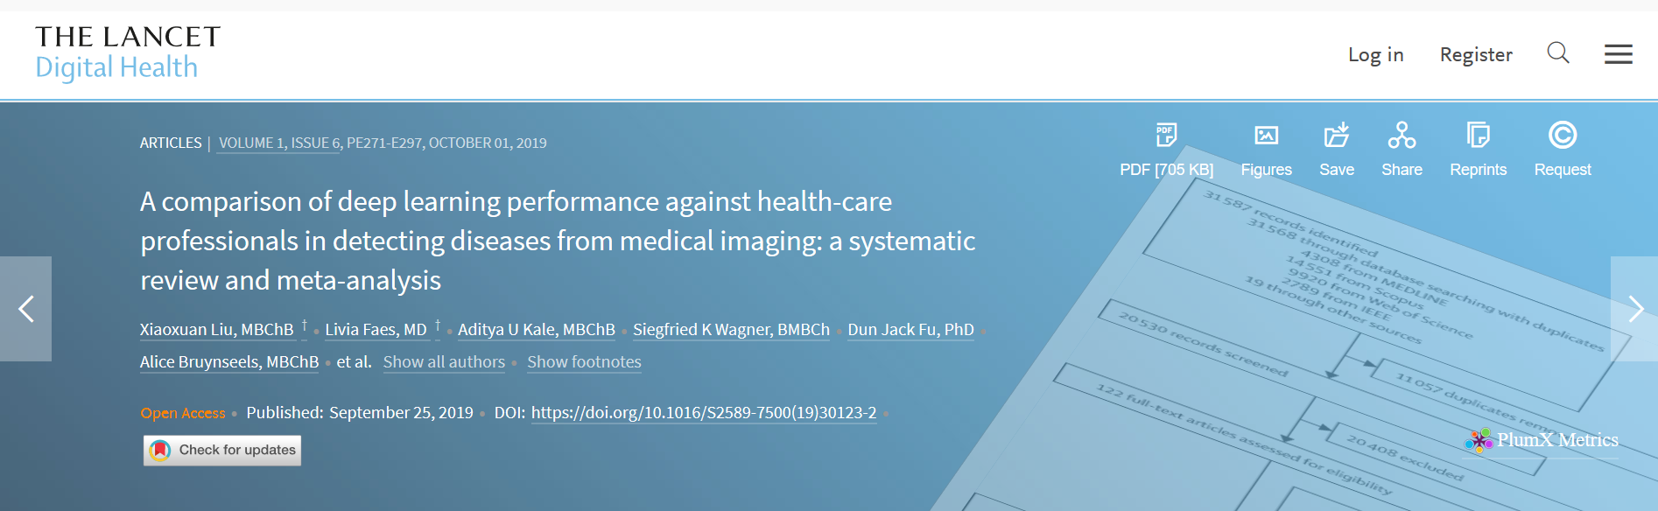
AI has real promise but study quality needs to be improved
performance of AI equivalent to health-care professionals
few studies presented externally validated results or compared performance to health-care professionals using the same sample

Slide 12
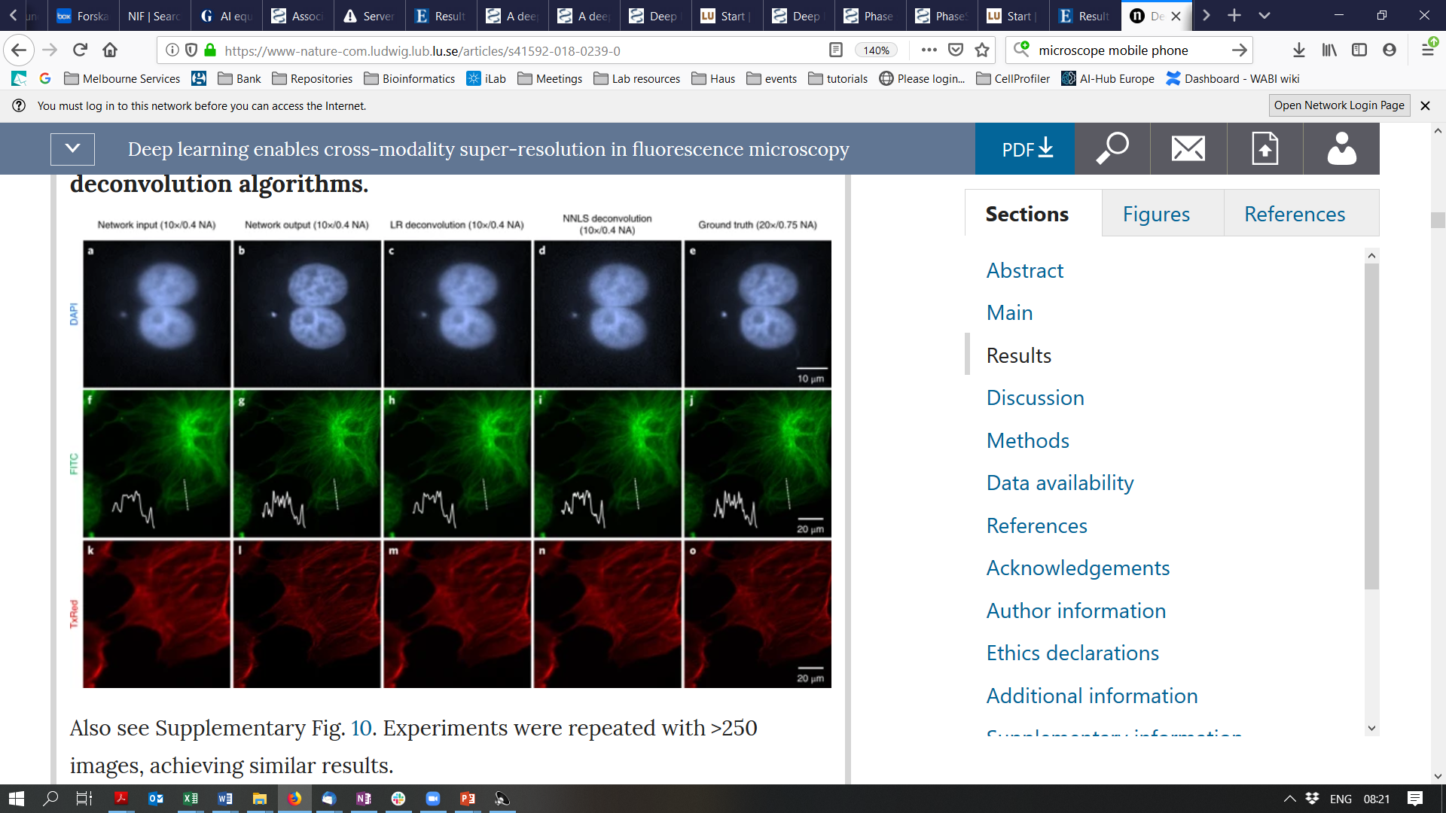
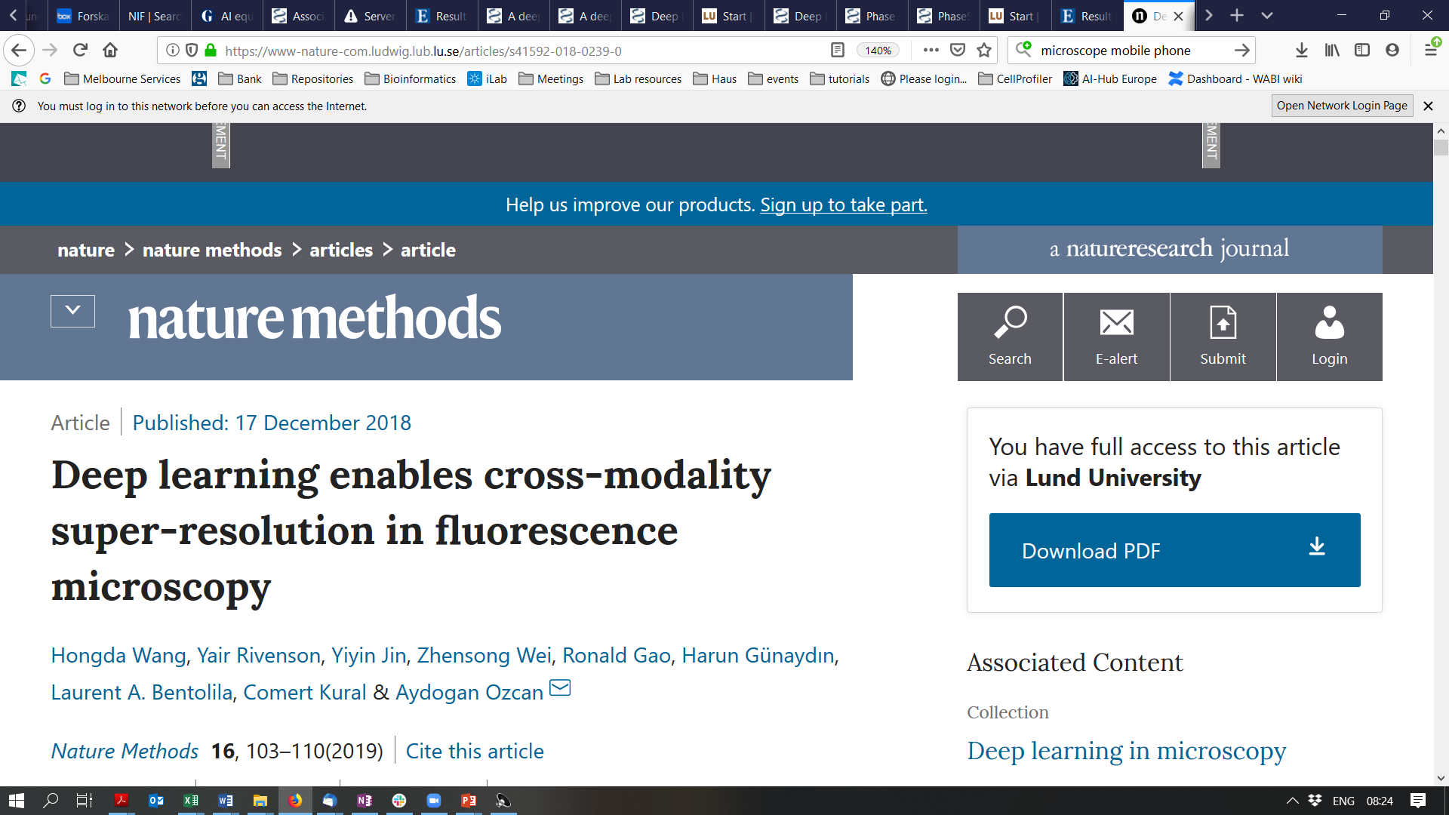
Improving resolution
Input
Output
Truth

Slide 13
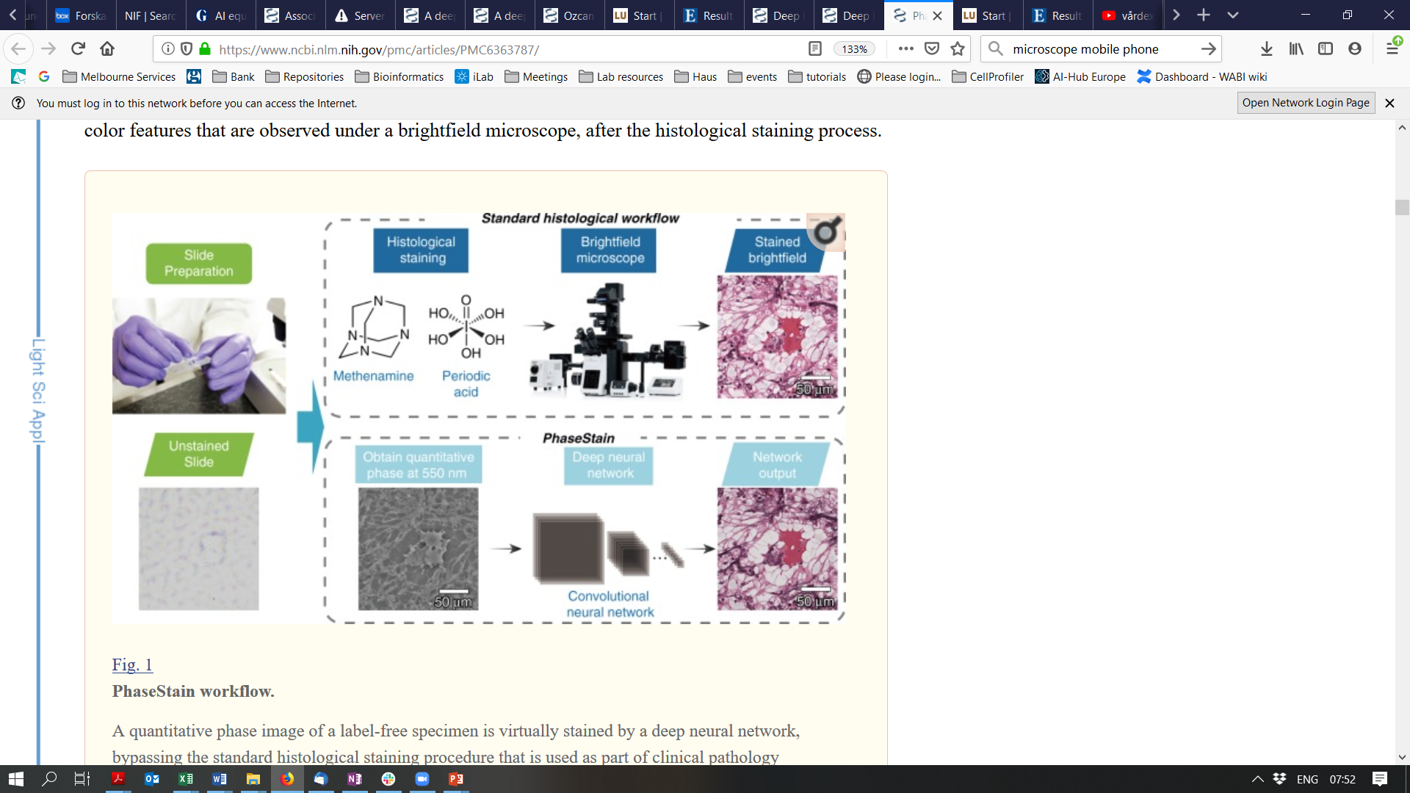
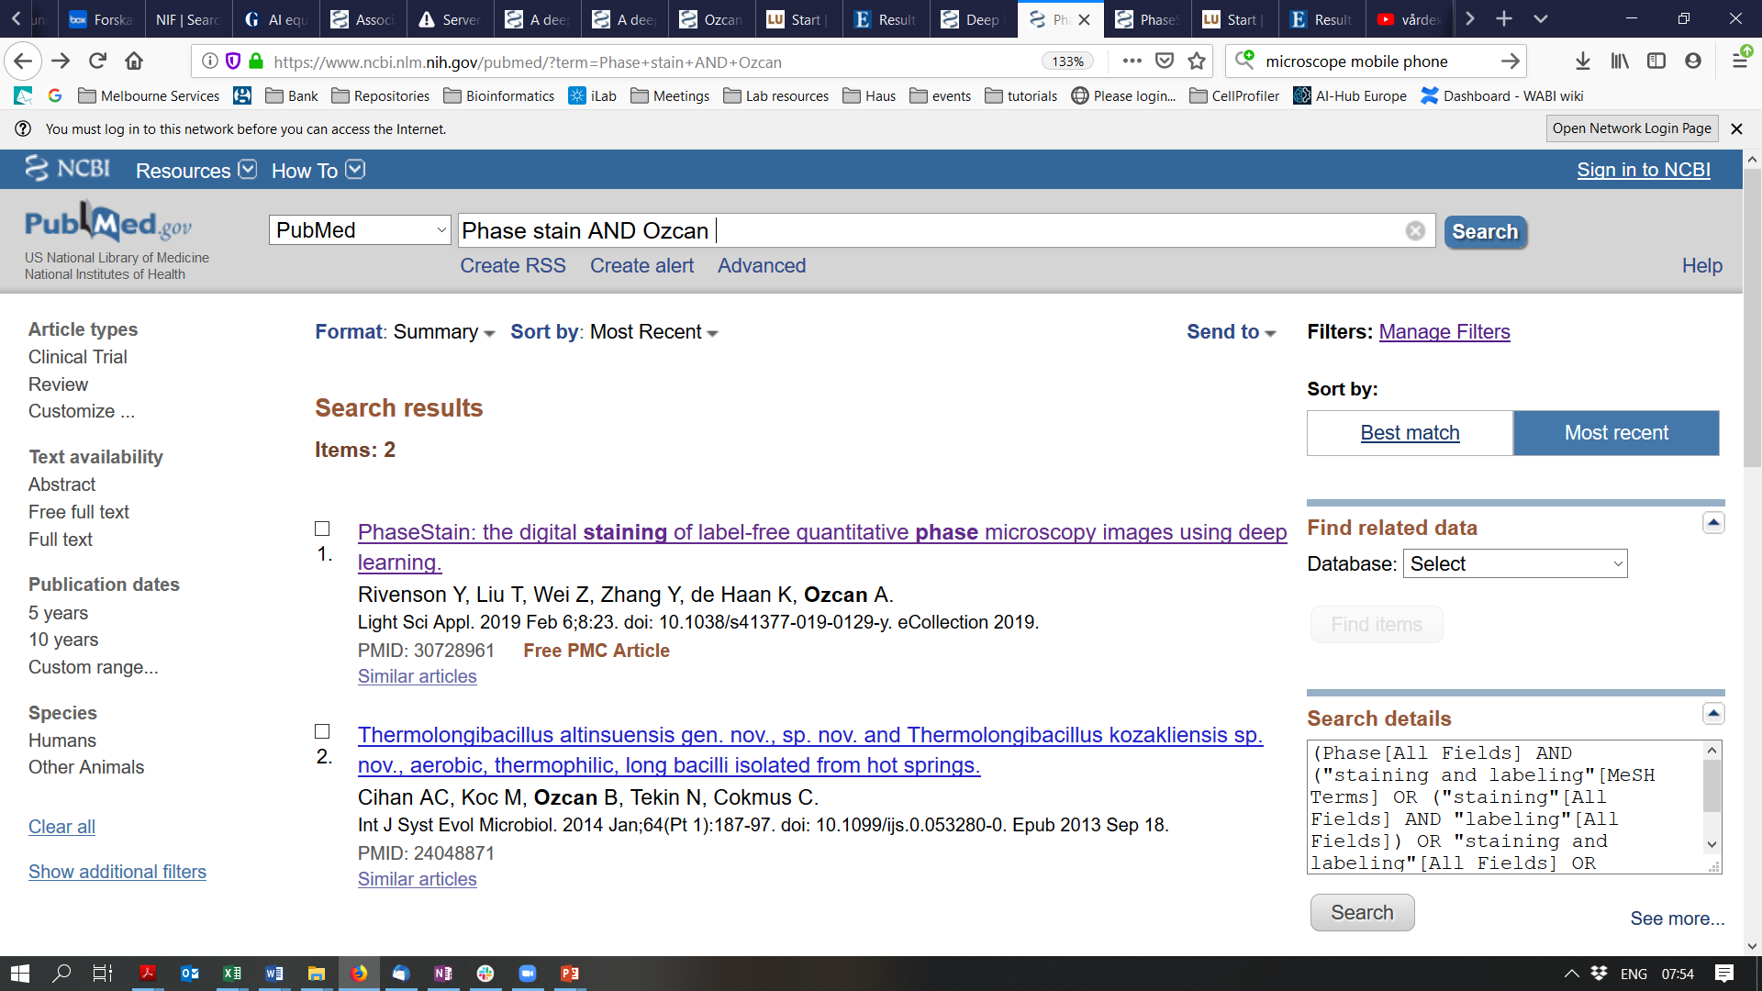
Virtual staining

Slide 14
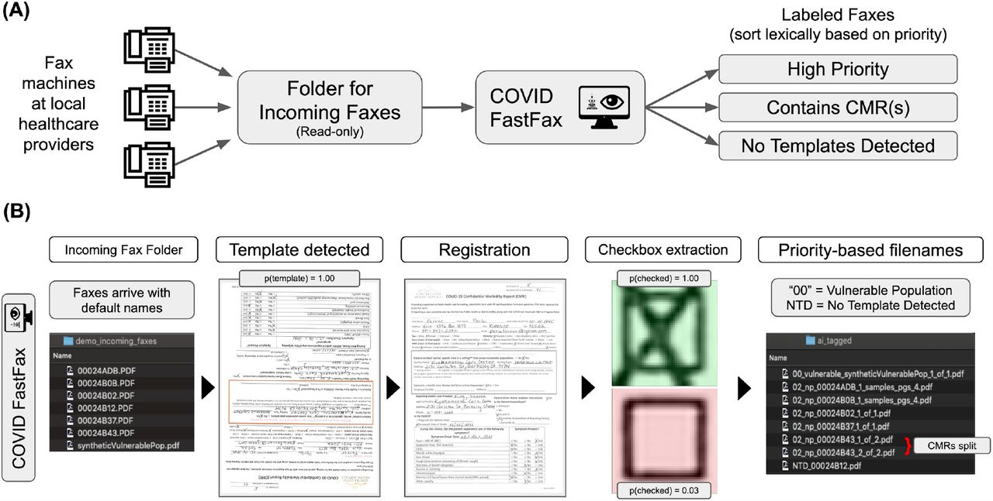
Assisting hospital logistics: COVID FastFax
Lavertu 2020, medRxiv https://www.medrxiv.org/content/10.1101/2020.12.15.20248256v1

Slide 15
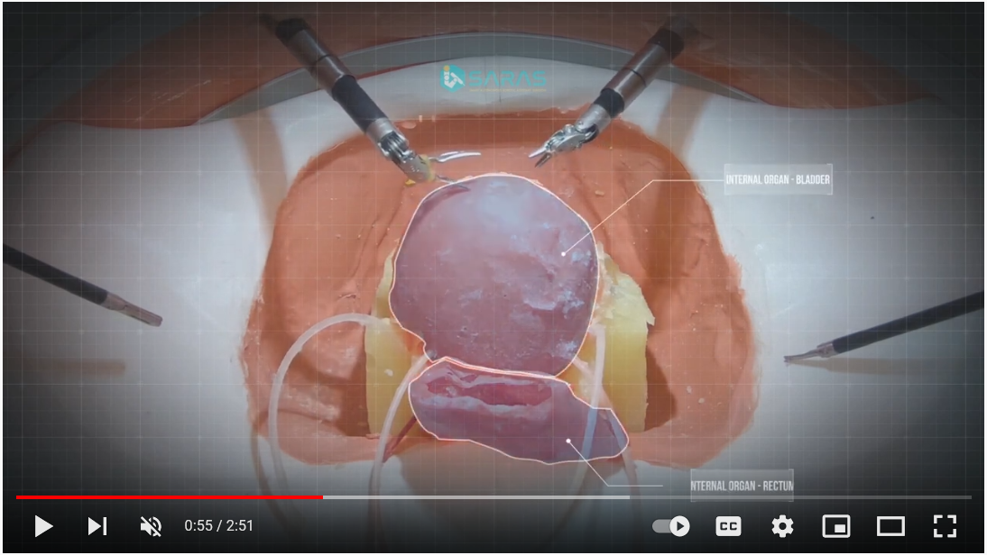
Autonomous robotic surgery
https://www.youtube.com/watch?v=XeYeAzsQ1-U

Slide 16
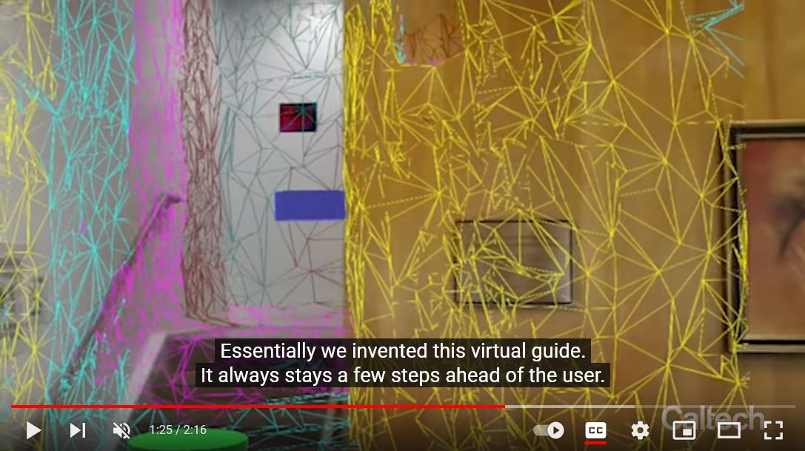
Computer vision-driven assistant devices
https://www.youtube.com/watch?v=vAGybwLb3kg

Slide 17
How to proceed with computer vision in your research?

Slide 18
Biomedical image repositories
https://idr.openmicroscopy.org/
https://www.ebi.ac.uk/bioimage-archive/
https://datasets.aida.medtech4health.se/
https://www.ebi.ac.uk/empiar/
https://www.cancerimagingarchive.net/
https://www.smir.ch/
http://www.cellimagelibrary.org/

Slide 19
Other data sources
https://www.lub.lu.se/service-stod/forskningsdata/soka-oppna-data
https://datasetsearch.research.google.com/
https://www.re3data.org/
https://www.kaggle.com/datasets
https://en.wikipedia.org/wiki/List_of_datasets_for_machine-learning_research
Repositories recommended by journals
https://journals.plos.org/plosone/s/recommended-repositories

Slide 20
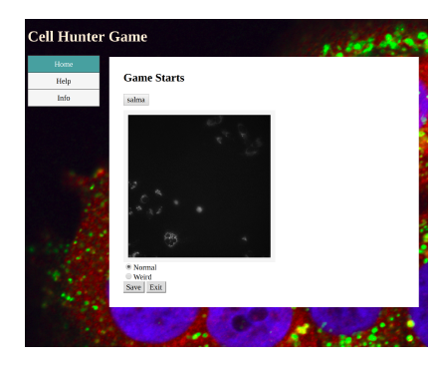
Getting your own data
Citizen science annotations

Slide 21
Keep track of the state of the art (SOTA)
Websites tracking SOTA
https://paperswithcode.com/
https://github.com/JunMa11/SOTA-MedSeg (medical images)
Community challenges (“shared tasks”)
https://grand-challenge.org/
Kaggle
Conferences
Recent research articles

Slide 22
Join local communities
COMPUTE: https://www.compute.lu.se/ research school (LU PhDs + staff)
AI Lund: http://ai.lu.se/ network for AI and machine learning
eHealth@LU: http://www.ehealth.lth.se network for digitalisation within medicine
eSSENCE: http://essenceofescience.se/ e-science network for Lund/Uppsala/Umeå
AI/Biocompute at LINXS: http://www.linxs.lu.se/ AI in x-ray and neutron science
HubAI: https://www.linkedin.com/company/hubai/ student organization

Slide 23
Learn more
Use self-learning materials on https://github.com/Aitslab/training
Form a peer-learning group
Watch videos from past AI Lund events
Come to an AI Lund drop-in session

Slide 24
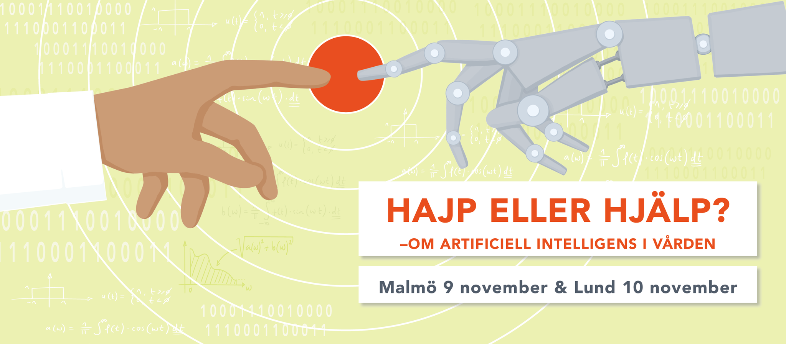
Forskningens dag 2021
https://www.vetenskaphalsa.se/forskningensdag/

Slide 25
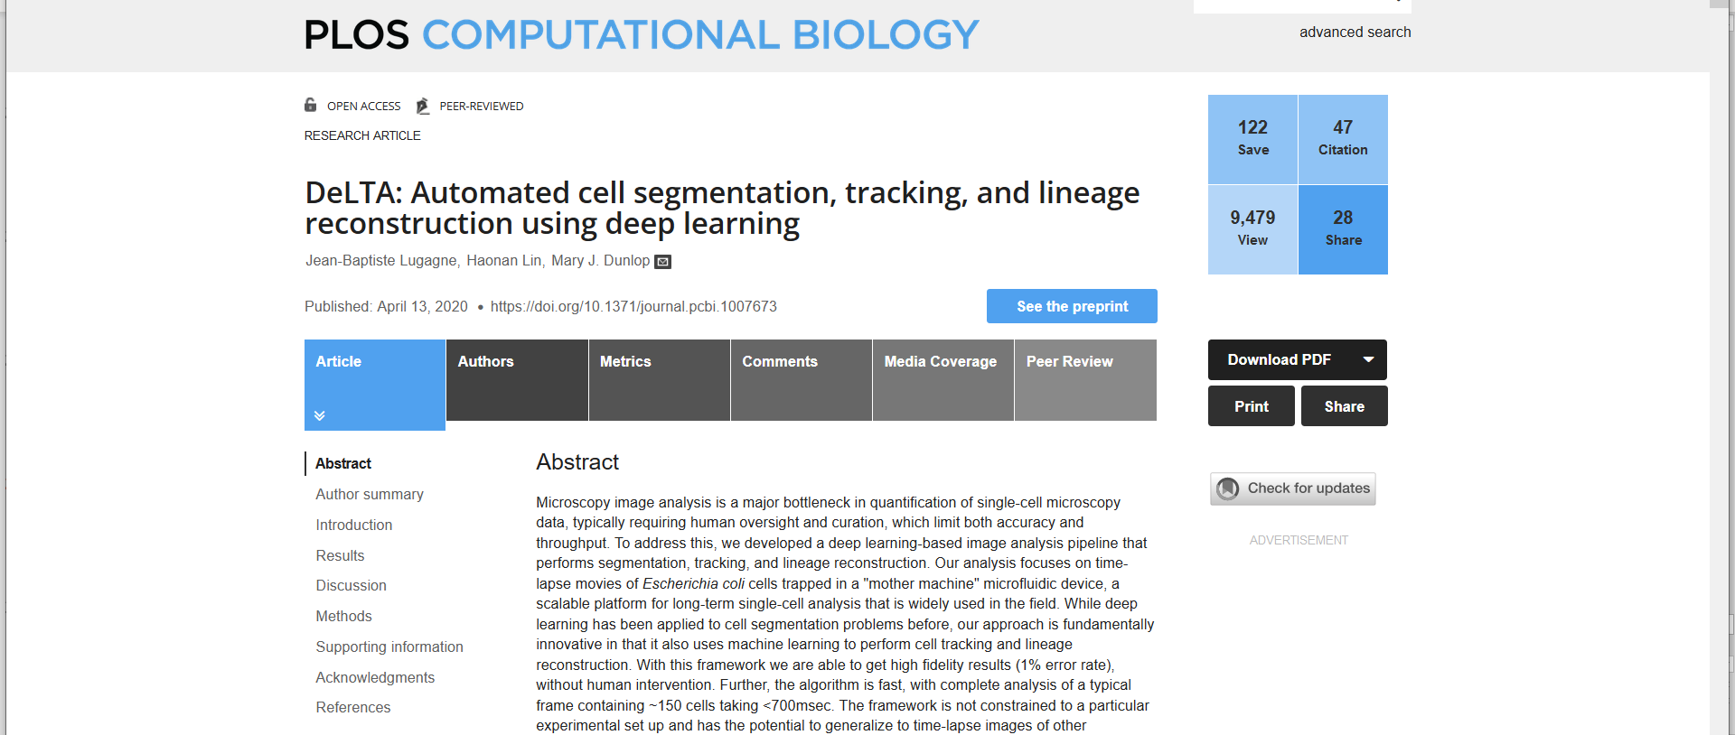
Journal club

Slide 26
Journal club questions
1. What was the goal of the study? What type of machine learning tasks were performed?
2. What type of data and of networks were used?
3. How were the models evaluated?
4. What are the limitations of the study?
5. What complementary or additional work should be done as a next step?
6. To what other research problems could these models be applied?

